Slide 1
Capstone Project-1
EDA On Hotel Booking Analysis by
Ramji Seth
(Cohort Cairo)

Slide 2
Problem Statement:
For this project we will be analyzing Hotel Booking data. This data set contains booking information for a city hotel and a resort hotel, and includes information such as when the booking was made, length of stay, the number of adults, children, and babies, and the number of available parking spaces.
Hotel industry is a very volatile industry and the bookings depends on above factors and many more.
The main objective behind this project is to explore and analyze data to discover important factors that govern the bookings and give
insights to hotel management ,which can perform various campaigns to boost the business and performance.

Slide 3
Work Flow :
So we will divide our work flow into following 3 steps.
DataCollection and Understanding
Data Cleaning and Manipulation
Exploratory Data Analysis(EDA)
EDA will be divided into following 3 analysis.
1) Univariate analysis: Univariate analysis is the simplest of the three analyses where the data
you are analyzing is only one variable.
2) Bivariate analysis: Bivariate analysis is where you are comparing two variables to study their
relationships.
3) Multivariate anlysis: Multivariate analysis is similar to Bivariate analysis but you are
comparing more than two variables.

Slide 4
Data Collection and Understanding:
After collecting data, it is very important to understand the data. So we had hotel Booking analysis data Which had 1,19,390 rows and 32 columns. So let’s understand these 32 columns.
^{Data Description:}
hotel :Resort Hotel or City Hotel
is_canceled : Value indicating if the booking was cancelled (1) or not (0)
lead_time : Number of days that elapsed between the entering date of the booking and the arrival date arrival_date_year : Year of arrival date
arrival_date_month : Month of arrival date
arrival_date_week_number : Week number of year for arrival date
arrival_date_day_of_month : Day of arrival date
stays_in_weekend_nights : Number of weekend nights
stays_in_week_nights : Number of week nights.
^{adults : Number of adults}
^{children : Number of children}
^{babies : Number of babies}
^{meal : Type of meal booked.}
^{country : Country of origin}

Slide 5
Data Collection and Understanding:
market_segment : Market segment designation (TA/TO) distribution_channel : Booking distribution channel(TA/TO) is_repeated_guest : is a repeated guest (1) or not (0) previous_cancellations : Number of previous bookings that were cancelled by the customer prior to the current booking
previous_bookings_not_canceled : Number of previous bookings not cancelled by the customer prior to the current booking reserved_room_type : Code of room type reserved. assigned_room_type : Code for the type of room assigned to the booking.
booking_changes : Number of changes made to the booking from the moment the booking was entered on the PMS until the moment of check-in or cancellation deposit_type : No Deposit, Non Refund , Refundable. agent : ID of the travel agency that made the booking
company : ID of the company/entity that made the booking . days_in_waiting_list : Number of days the booking was in the waiting list before it was confirmed to the customer customer_type : type of customer. Contract,Group,transient,Transient party. adr : Average Daily Rate as defined by dividing the sum of all lodging transactions by the total number of staying nights required_car_parking_spaces : Number of car parking spaces required by the customer total_of_special_requests : Number of special requests made by the customer (e.g. twin bed or high floor)
reservation_status : Reservation last status.

Slide 6
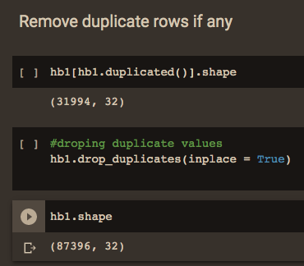
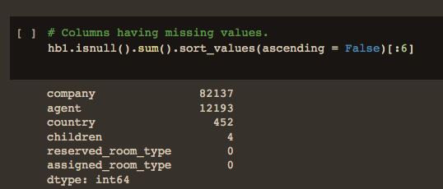

Data Cleaning and Manipulation:
Step 1: Removing duplicate rows if any
Step 2: Handling missing values.
Null values in columns company and agent were replaced by 0.
Null values in column children were replaced by the mean of the column. Null values in column country were replaced by 'others'.

Slide 7
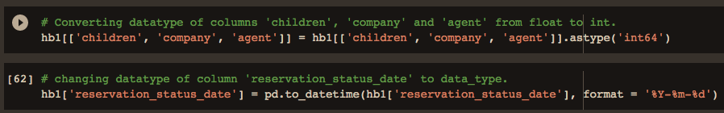
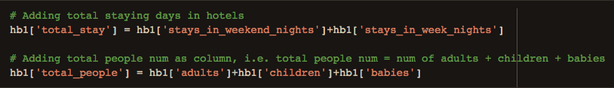
Data Cleaning and Manipulation:
Step 3: Converting columns to appropriate datatypes.
Step 4: Adding important columns

Slide 8
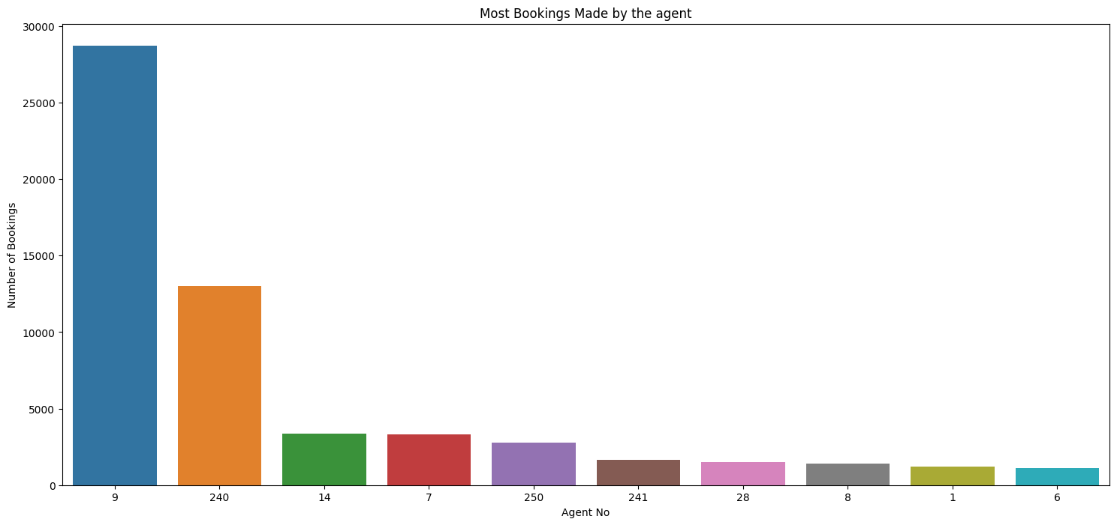
Exploratory Data Analysis (EDA) :
Agent made the most no. bookings
Conclusion
Agent Id no -9 made the highest bookings which is more than 28721.

Slide 9
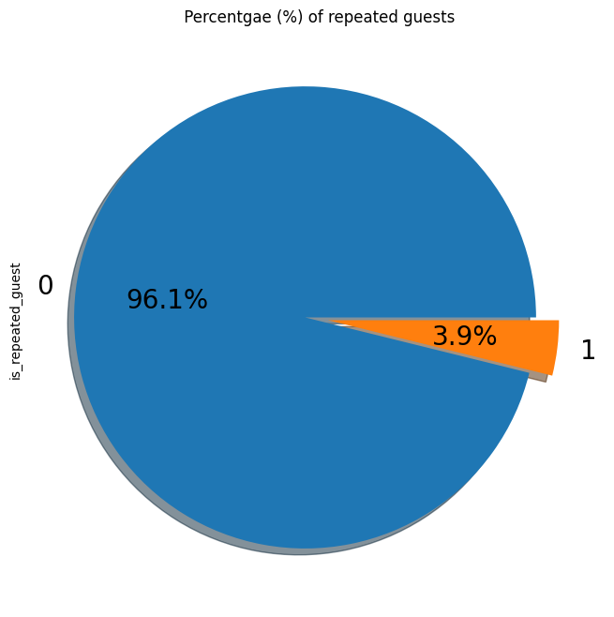
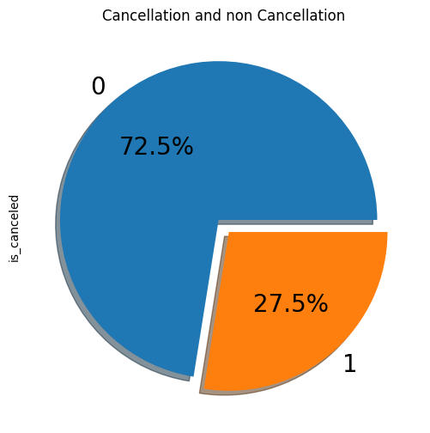
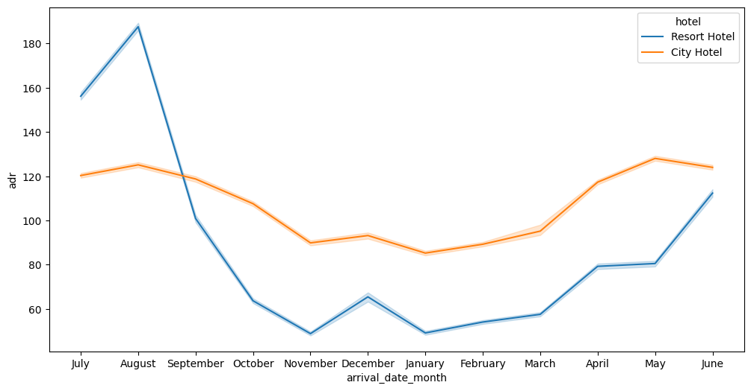
Exploratory Data Analysis (EDA) :
Which months have cheaper booking rates
Conclusions:
Only 3.9 % people were revisited the hotels. Rest 96.1 % were new guests. Thus retention rate is low.
27.5 % bookings were cancelled out of all the bookings
For both city and resort hotels, Nov to Jan have cheaper average daily rates

Slide 10
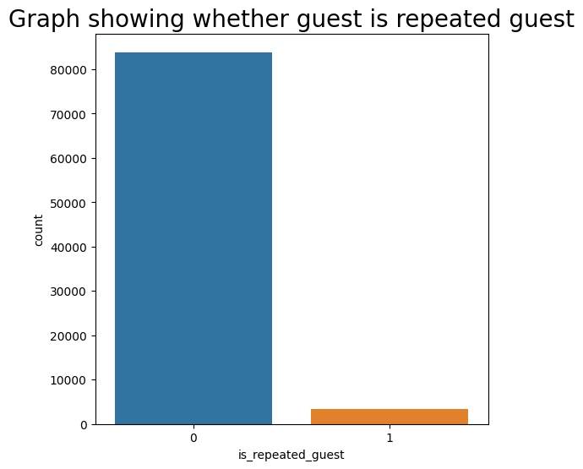
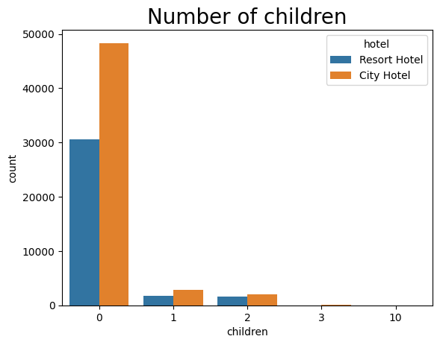
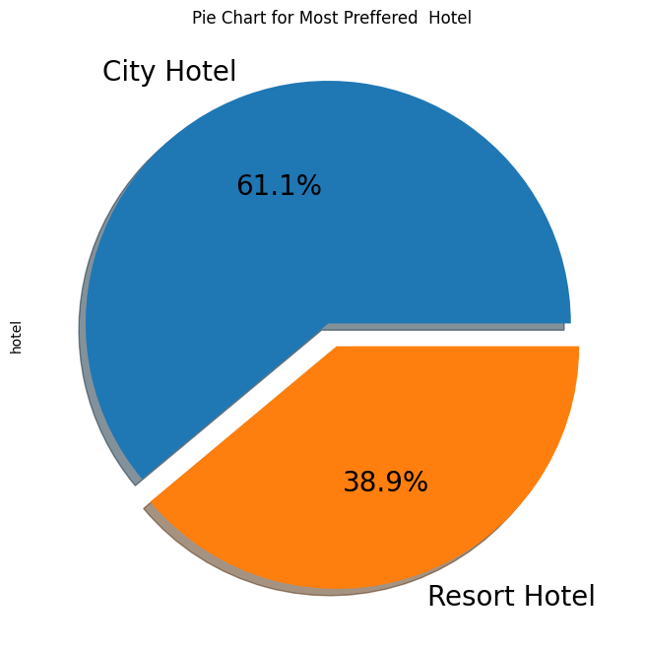
Exploratory Data Analysis (EDA) :
Conclusions:
Most customers are not repeating their booking.
Families with children have no particular preference for the hotel type
City hotels is the most preferred hotel type by the guests. We can say City hotel is the busiest hotel.

Slide 11
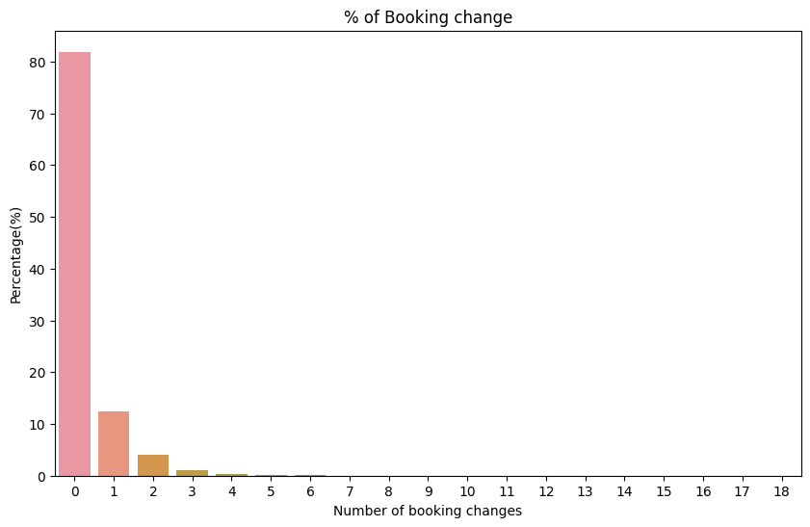
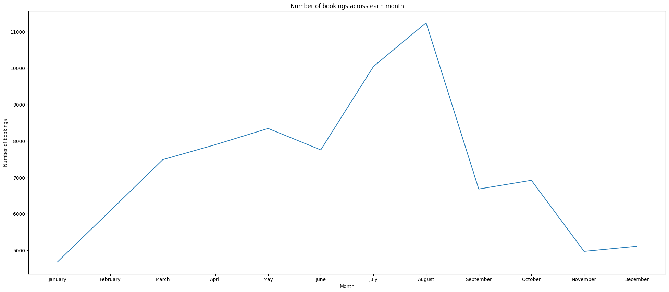
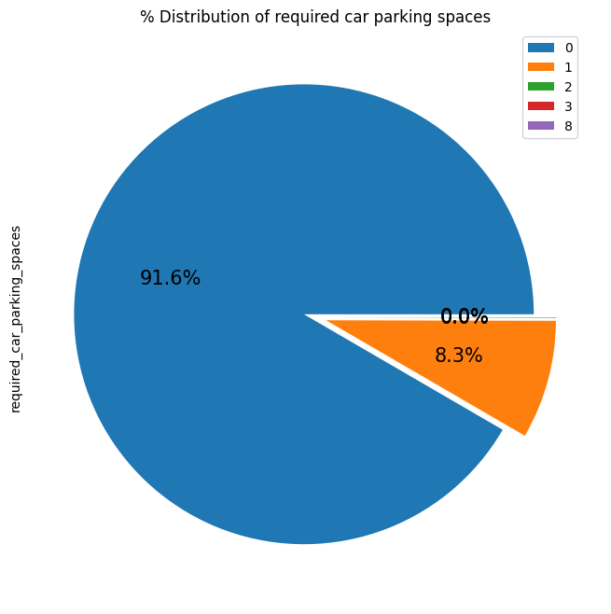
Exploratory Data Analysis (EDA) :
Conclusions:
The percentage of 0 changes made in the booking was more than 82 %. Percentage of Single changes made was about 10%.
As we can see in the line chart, from June to September most of the bookings happened. It’s Summer time. After September bookings Starts declining
Most of the customers(91.6%) do not require car parking spaces. Only 8.3 % people required only 1 car parking space.

Slide 12
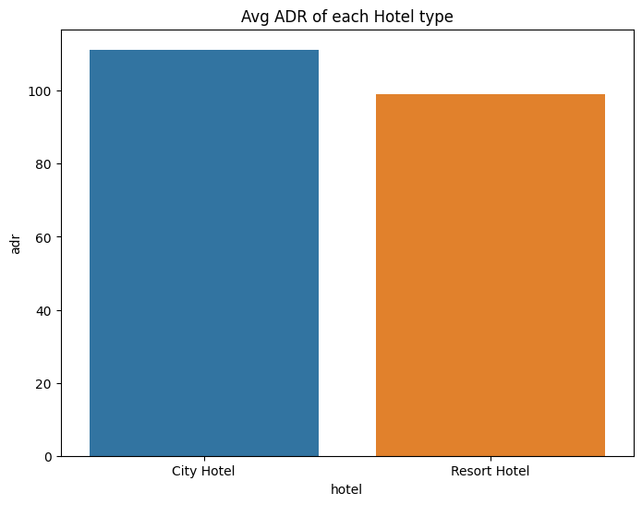
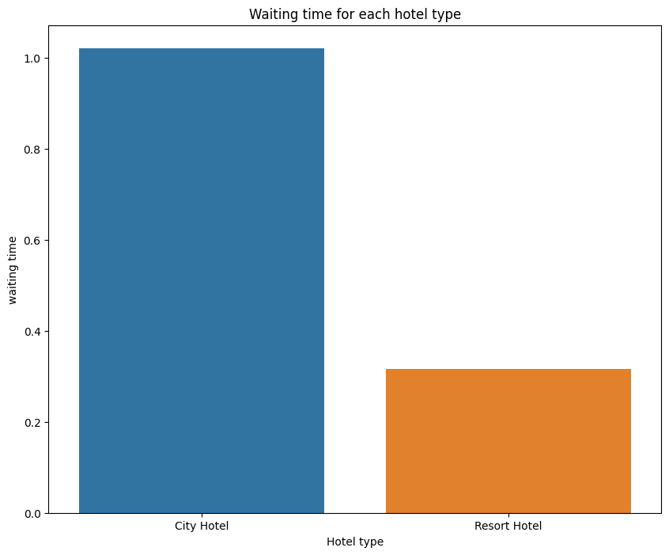
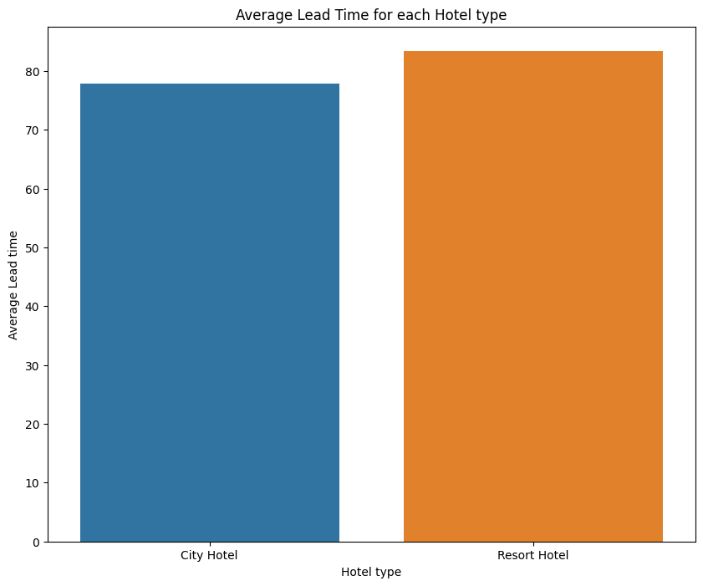
Exploratory Data Analysis (EDA) :
Conclusions:
Average ADR for city hotel is high as compared to resort hotels. These City hotels are generating more revenue than the resort hotels.
Waiting time period for City hotel is high as compared to resort hotels. That means city hotels are much busier than Resort hotels.
Average lead time for resort hotel is high. It means people plan their trip too early. Usually people prefer resort hotels for longer stays. That’s why people plan early

Slide 13
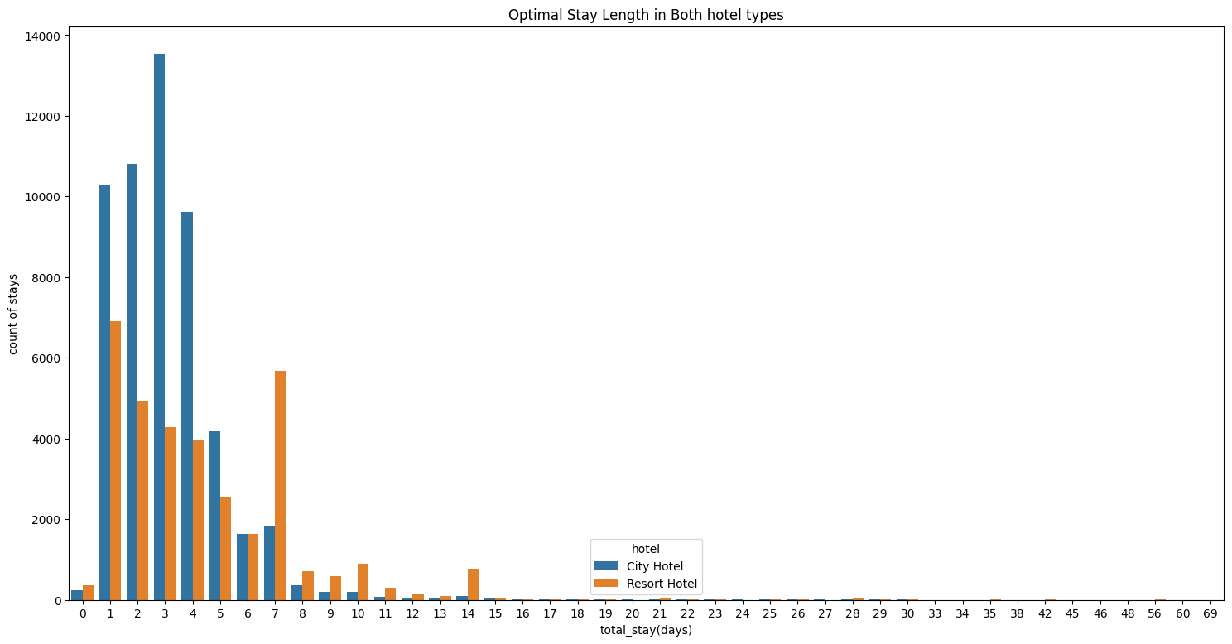
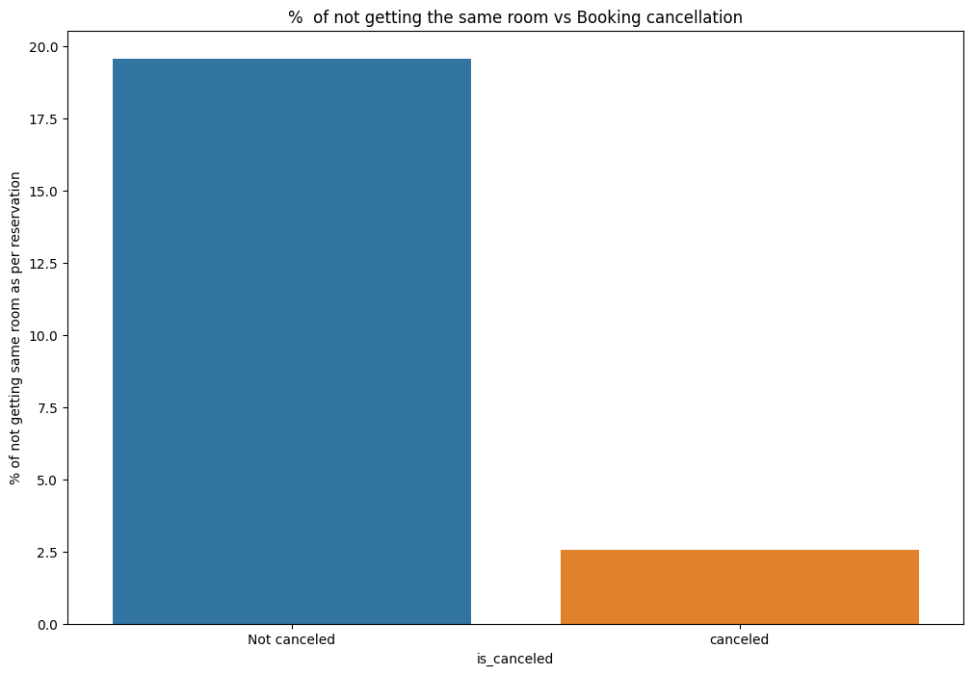
Exploratory Data Analysis (EDA) :
Conclusions:
Optimal stay in both the type hotel is less than 7 days. Usually people stays for a week.
For stay more than 7 days people likes to stay in Resort hotels. As we can see after 7 days City Hotel Bookings are very less as compared to Resort hotels.
Almost 19 % people did not canceled their bookings even after not getting the same room which they reserved while booking hotel. Only 2.5 % people cancelled the booking.
Thus not getting the same room as per reserved room is not the reason for booking cancellations.

Slide 14
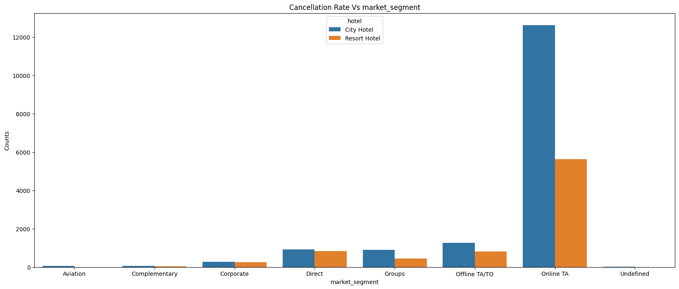
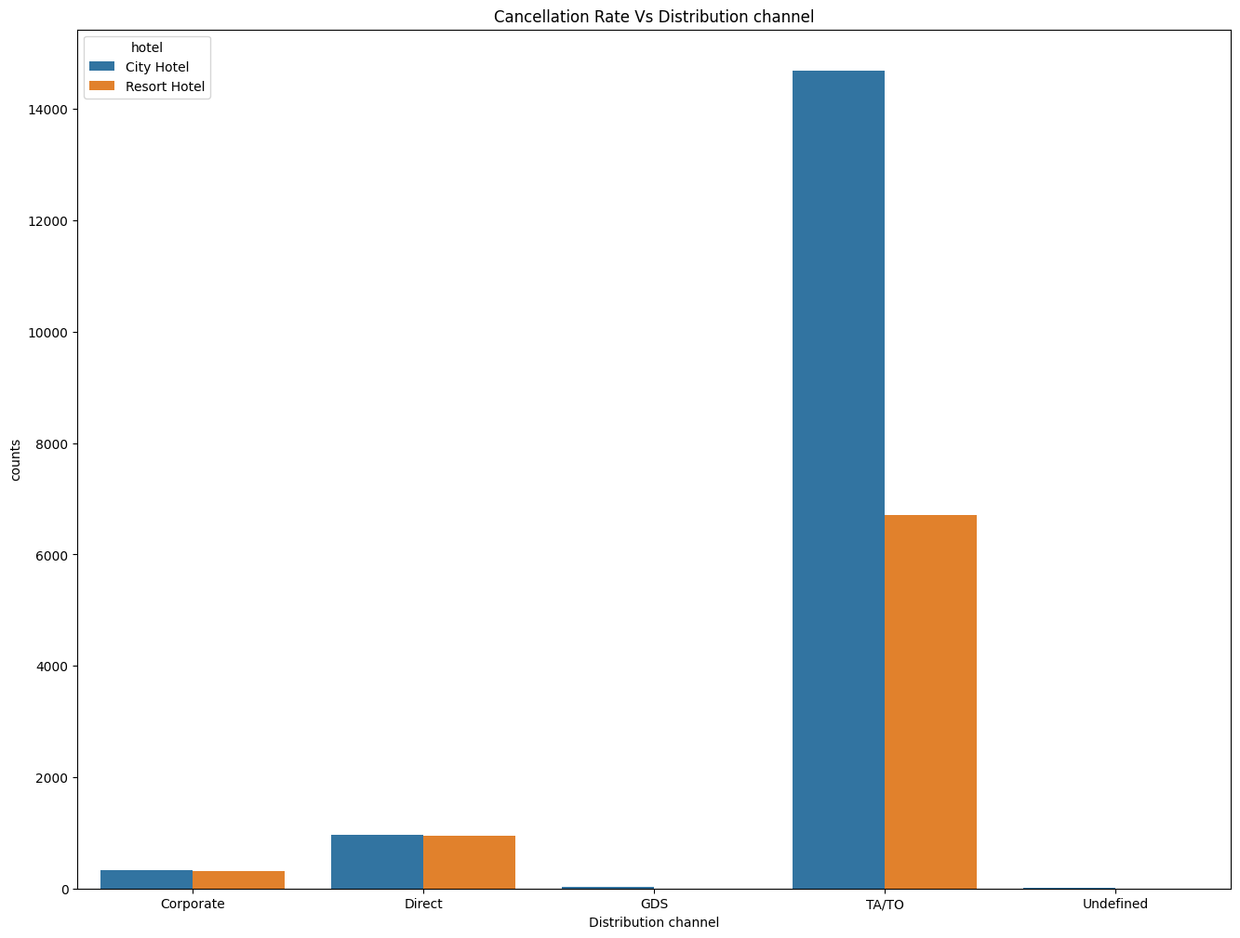
Exploratory Data Analysis (EDA)
Conclusions:
^{Market Segment:}
Online TA/TO’ market segment has highest cancellations for city hotels.
^{Distribution channel:}
‘TA/TO’ distribution channel has highest cancellations for city hotels and more than 6000 cancellations for resort hotels. In order to reduce the cancellations they should improve their cancellation policies and deposit policies.

Slide 15
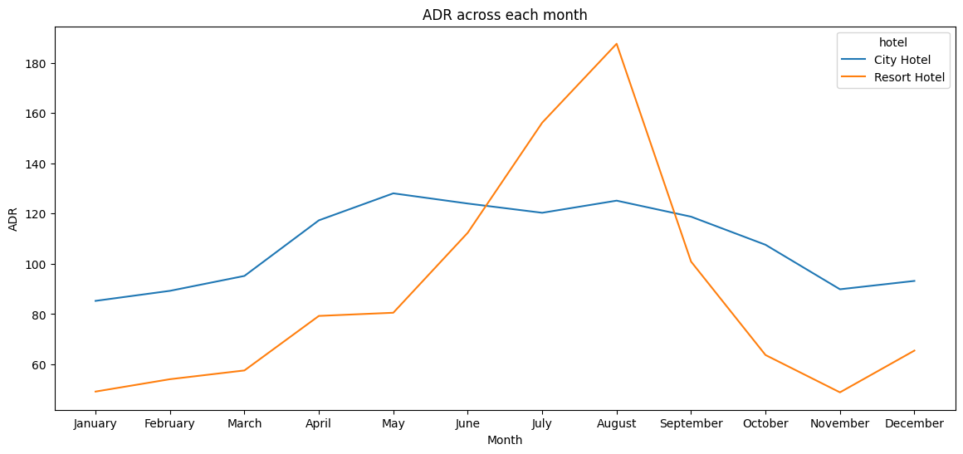
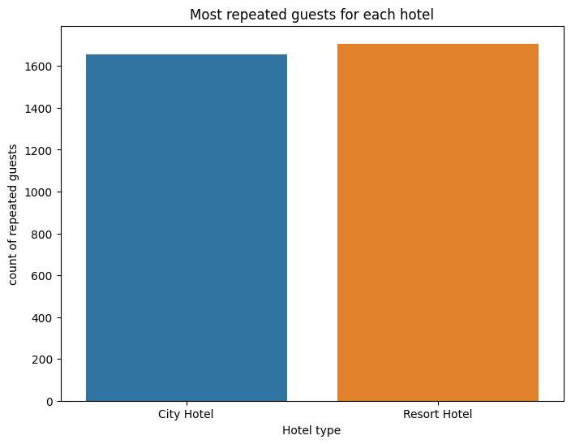
Exploratory Data Analysis (EDA)
Conclusions:
Resort hotels had the highest adr in June ,July and August than the City hotels. But in other months adr of Resort hotel was less than the City hotels
Thus we can say that, the January, February, March, April ,November and December are the good months for customers to get good adr
Resort hotels has the most repeated guests. In order to get increase the count of repeated guests hotel management need to take the valuable feedbacks from the guests and try to give good service.

Slide 16
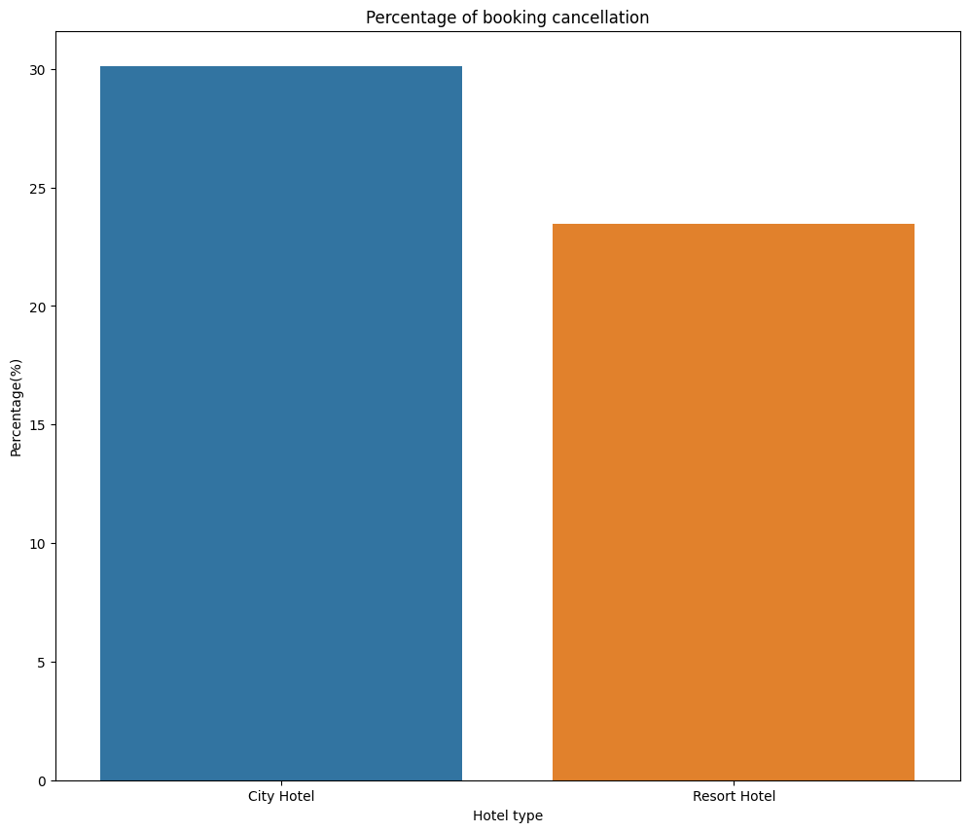
Exploratory Data Analysis (EDA)
Conclusions:
Booking cancellation rate is high for City hotels which almost 30 %.

Slide 17
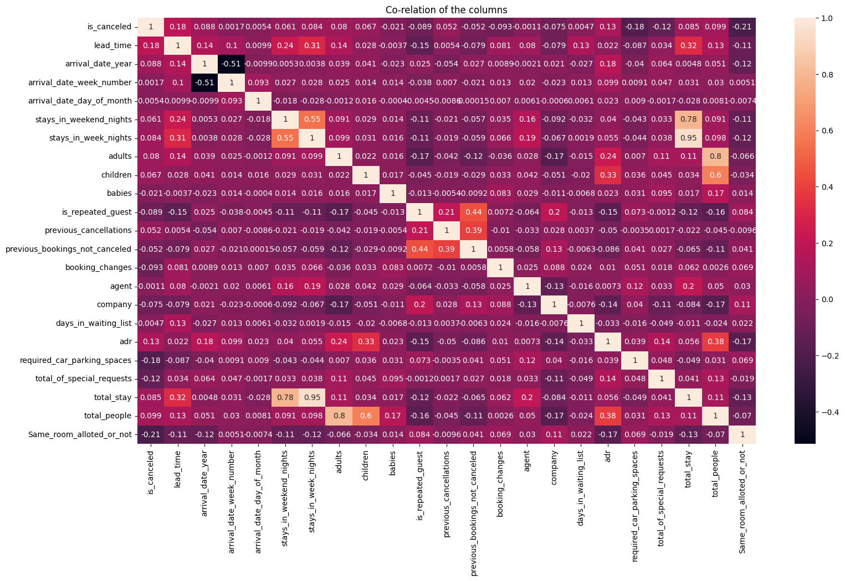
Exploratory Data Analysis (EDA)
Conclusions:
is canceled and same_room_alloted_or_not are negatively correlated. Not getting the same room as per reserved room is not the reason for booking cancellations.
lead-time and total stay is positively correlated means that the more the guest’s stay, more will be the lead time.
ADR and total people are highly correlated. That means more the people more will be the adr. High adr means high revenue
is_repeated_guest and previous_bookings Not_canceled has strong correlation. May be repeated guests are not more likely to cancel their bookings.

Slide 18
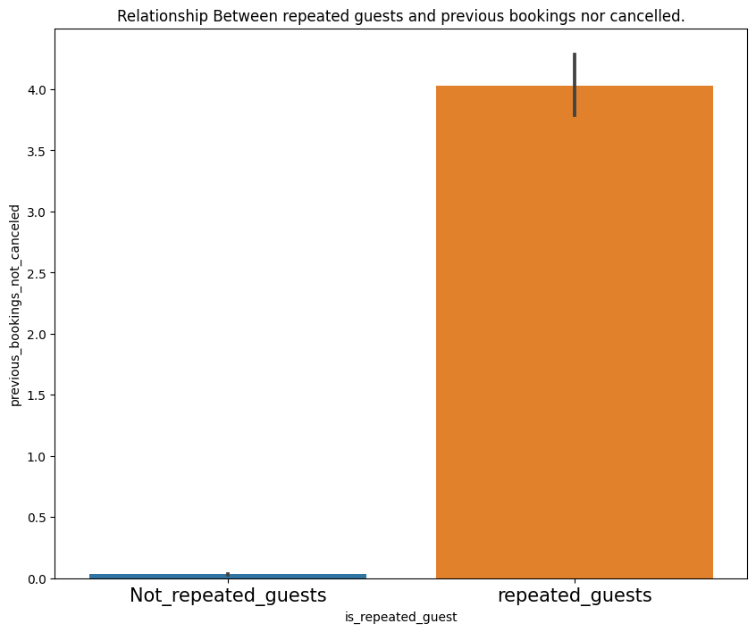
Exploratory Data Analysis (EDA)
Conclusions:
Not Repeated guests are more likely to cancel their bookings.

Slide 19
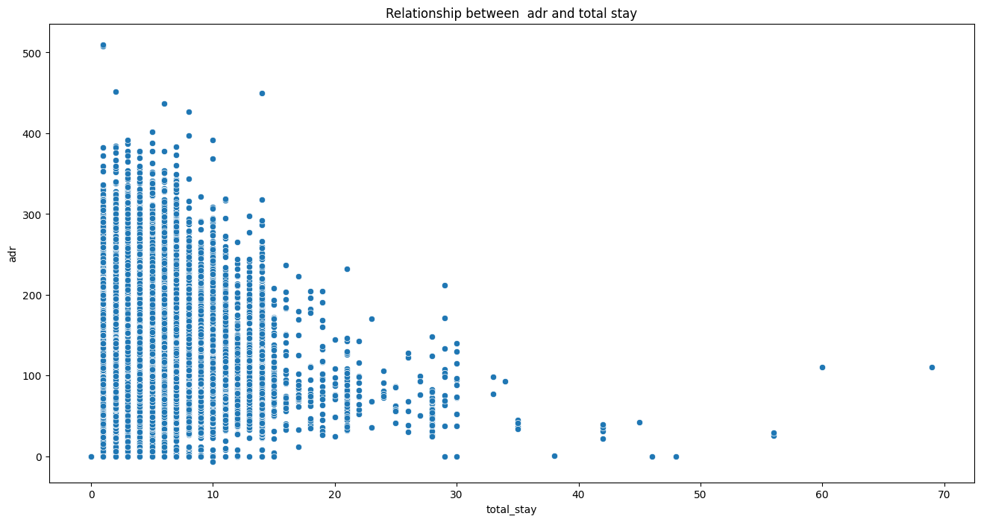
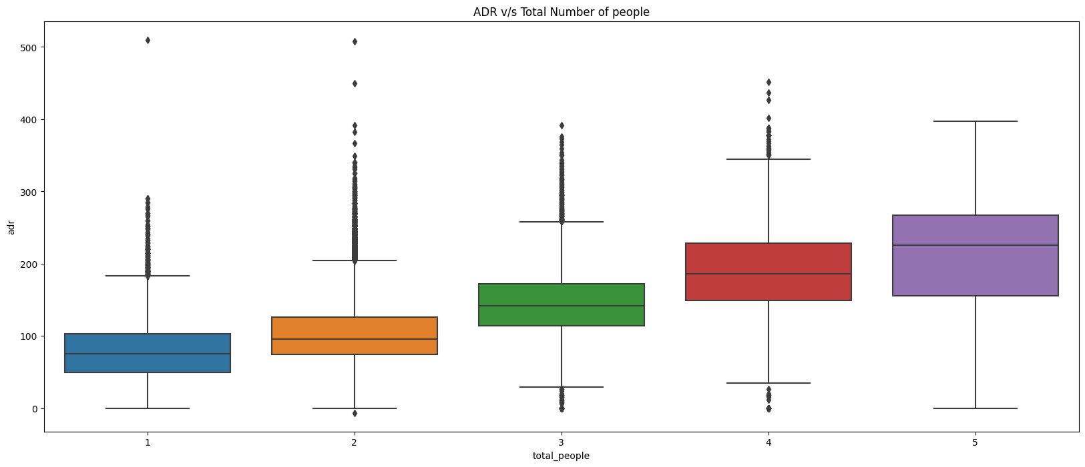
Exploratory Data Analysis (EDA)
Conclusions:
From above scatter we can say that as the stay increases adr is decreasing. Thus for longer stays customer can get good adr.
As we saw in Correlation heatmap, total people and adr are positively correlated. Thus for 2 people ,adr is almost 100 and for 5 people it is more than 200.
Thus more the people, more will be the revenue of the hotels.

Slide 20
Thank you

